Slide 1
Car Price Prediction
Prepared By: Bhumik P Shah

Slide 2
Conceptual Background of the Domain Problem
Determining whether the listed price of a used car is a challenging task, due to many factors that drive a used vehicle’s price on the market.
The prices of new cars in the industry is fixed by the manufacturer with some additional costs incurred by the Government in the form of taxes.
So, customers buying a new car can be assured of the money they invest to be worthy.
But due to the increased price of new cars and the incapability of customers to buy new cars due to the lack of funds, used cars sales are on a global increase.
It is important to know their actual market value while both buying and selling.

Slide 3
Motivation for the Problem Undertaken
Being extremely interested in everything having a relation with the machine Learning, the independent project was a great occasion to learn and confirm my interest for.
Deciding whether a used car is worth the posted price when you see listings online can be difficult.
From the perspective of a seller, it is also a dilemma to price a used car appropriately.
Based on existing data, the aim is to use machine learning algorithms to develop models for predicting used car prices.

Slide 4
Data Sources and their formats
The data is collected from cardekho.com for different locations using web scrapping tool selenium.
The dataset contains 5091 records (rows) and 10 features (columns) with car_ price feature being the target attribute.
All the features in these dataset are of object datatype.

Slide 5
Data Preprocessing
Extracting out new features named as Brand, model and manufacturing year from the existing feature car_details and finally dropping the feature car_details as all the useful information is extracted.
On the similar lines new feature driven_kilometer is extracted from used_kilometer . Further, the new feature driven_kilometer is having object datatype it is to be converted into float datatype as kilometer is always a numerical value.
Similarly new features named as owners and car price are extracted from the existing feature owner and price and dropping the existing feature after extracting the useful information from it.
The new feature car_price is having object datatype is converted into float datatype as a car price is always a numerical value.

Slide 6
Outliers detection and Treatment
Data Visualization is the graphical representation of the information and data. Further, by using visual elements like charts, graphs and maps data visualization tools provide an accessible way to see and understand trends, outliers and patterns in data.
The outlier detection is carried out using boxplot and distribution plot .
The outliers are treated using IQR method instead of removing them ,as removing the outliers will create data loss which should be avoided as data is vital and costly.

Slide 7
Skewness
Skewness is the degree of distortion from a normal distribution.
If the values of a certain independent variables (features) are skewed, depending on the model, skewness may violate model assumptions or may impair the interpretation of feature importance.
All the numerical features i.e independent features in these dataset are having skewness less than 0.5 and hence there is no need to treat it.

Slide 8
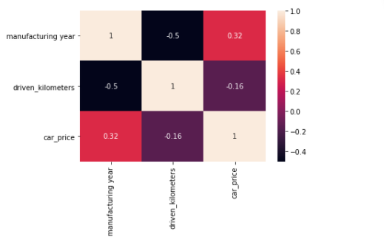
Correlation
Correlation is an indication about the changes between two variables.
As per the heatmap it can be said that the target/label attribute Car_price is having positive linear correlation with manufacturing_year.
The feature driven_kilometers is having very less correlation with the target attribute it can be dropped from the dataset but I am not dropping it as data is vital and costly.

Slide 9
Training the Model
The categorical columns are converted into numeric type using label encoder.
Standard Scaling is applied first before splitting the data into train_test_split.
The various algorithms like Linear Regression, Decision Tree Regressor, SVR, K Neighbors Regressor, Ada Boost Regressor, Gradient Boosting Regressor, Random Forest Regressor, Lasso , Ridge are used.
First approach is to find r2 score using all mentioned algorithms and finding the best model amongst it.
The cross validation is carried out for all the mentioned algorithms to help us find the best model.

Slide 10
Model Performance
Model Name | r2_score | cross_val_score | difference
Linear Regression | 0.35 | 0.36 | -0.01
Decision Tree Regressor | 0.65 | 0.46 | 0.19
SVR | 0.41 | 0.49 | -0.08
K Neighbors Regressor | 0.47 | 0.49 | -0.02
Ada Boost Regressor | 0.29 | 0.21 | 0.08
Gradient Boosting Regressor | 0.67 | 0.68 | -0.01
Random Forest Regressor | 0.7 | 0.7 | 0
Lasso | 0.36 | 0.36 | 0
Ridge | 0.36 | 0.36 | 0

Slide 11
Hyper Parameter Tuning
The difference between r2 score and cross validation score is minimum for Linear Regression, Gradient Boosting Regressor, Random Forest Regressor, Lasso and ridge.
. To find the best models amongst these can be done using Hyper tuning where the parameters are tuned to get better r2_score as compared to the one’s without tuning.
Based on Hypertuning Gradient Boosting Regressor is my best model with r2_score of 81%.

Slide 12
Thank You

